Slide 1
Human-Computer Interaction
COMS30029
aka #HCI_Theory
Week 2: First Wave
Oussama Metatla and Dan Bennett
Chunk 1: Introduction

Slide 2
Oussama Metatla (and Dan Bennett)
Week 2: First Wave
Chunk 1: GOMS and Fitts’ Law
Mathematical models of user behaviour
Notes:
Last lecture we introduced the first wave of HCI and discussed 3 broad approaches to theory in HCI that will be relevant throughout the course. In this lecture we’re going to look in detail at two mathematical models of user cognition from the first wave of HCI. GOMS and Fitts’ law. These have both been hugely influential and are still under active research.

Slide 3
GOMS and Fitts’ Law
Fitt’s Law: predicting performance on mouse tasks
GOMS: predicting performance on a range of input tasks (Goals, Operators, Methods and Selection rules)
Both grounded in cognitive psychology
Both expanded and developed in HCI
Narrow, and precise, and focused on particular phenomena
Notes:
**Fitts’ Law** predicts performance on mouse tasks, and
**GOMS** is a set of models for understanding human performance on user input tasks. GOMS stands for Goals, Operators, Methods and Selection rules.
Both of these approaches were based on ideas and methodologies from cognitive psychology, but developed and expanded in HCI. Both offer very precise ways of understanding particular phenomena, and both have continued to be updated and expanded over the years. Compared to some of the theories we will see later in the course, both are very narrow and precise in dealing with very particular phenomena, but have little to say beyond that.

Slide 4
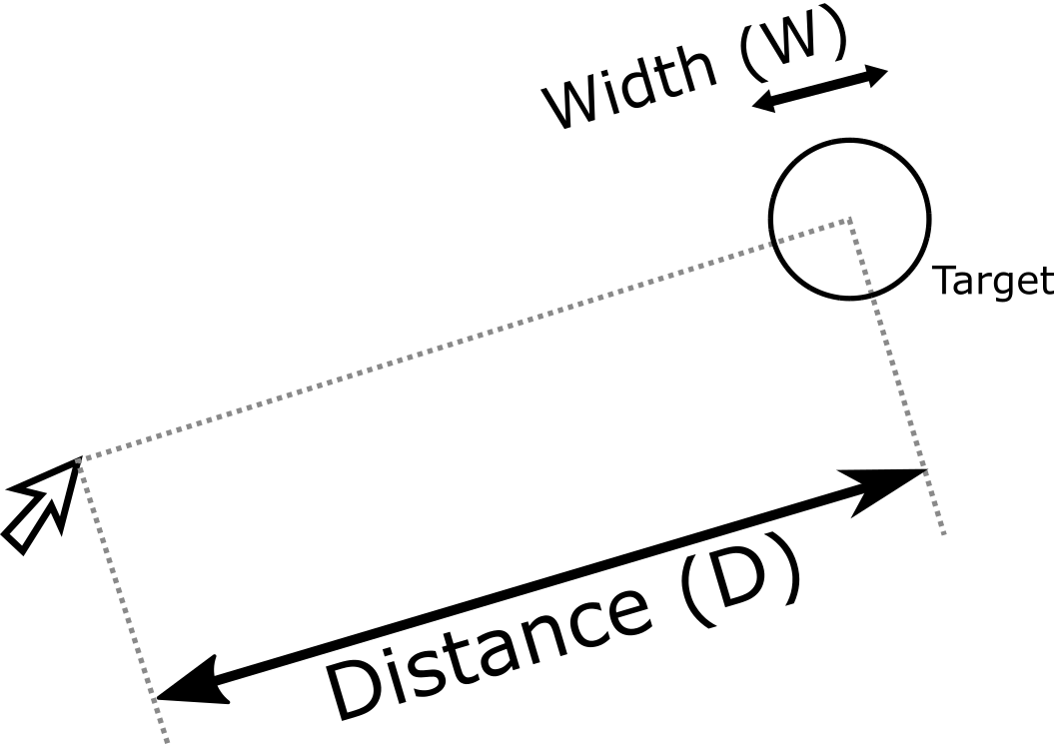
Fitts’ Law: pointing, parameterised!
Originally developed to understand pointing with a finger
HCI adopted and extended to understand mouse, touchscreen use, and other examples of cursor control
Posits a speed-accuracy trade-off in movement towards a target, and quantifies this
Notes:
Fitts’ law is one of the most enduring, and precise theories in Human Computer Interaction.
In the next two slides I’ll introduce the theory and then I’ll move on to talk about how it’s used in design.
It gives a simple equation describing pointing behaviour. HCI researchers use this to predict how much time it will take for a person to move a mouse cursor or finger from one point on the screen to land inside a target, somewhere else on the screen.
The original version of Fitts’ Law was developed by psychologist Paul Fitts, in 1954, to describe pointing and touching targets with a finger. It has subsequently been adopted and developed in HCI, so that there are now many variations on Fitts’ law. All share one basic idea: that there is a determinate, quantifiable, speed-accuracy trade-off in movement towards a target. The law predicts that users will make more errors, the faster they move to a target, and the smaller the target, and it says that we can capture this effect numerically, to a reasonable degree of precision.

Slide 5
Fitts’ Law: pointing, parameterised!
time
Index of difficulty
T = a + b log2(2D / W)
“delay”
“acceleration”
Notes:
T is time, given an acceptable error rate. D is distance, and W is the width of the target along the axis of movement. a and b are constants which need to be found empirically from the data. We can do this using linear regression
Many of you will be sitting there thinking this is not such a revolutionary idea, it seems pretty obvious. But I think we can show that it’s more useful than you might expect.
As I explain this, I’m going to use Fitts’ law as an example to talk more generally about what good theory use can look like.

Slide 6
Fitts’ Law: pointing, parameterised!
Three ways to use Fitt’s Law
High Level qualitative-quantitative engagement
Mathematical Engagement with the model
Further Theory Building
time
Index of difficulty
T = a + b log2(2D / W)
“delay”
“acceleration”
Notes:
We’re going to talk about three ways you can use Fitts’ law

Slide 7
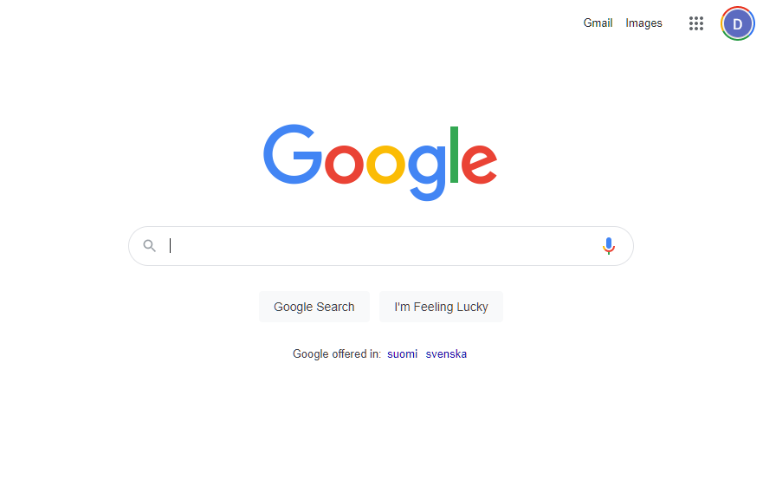
Fitts’ Law: pointing, parameterised!
1. High Level qualitative-quantitative engagement
Further = harder / slower
So:
Minimise length of mouse moves
Control the user’s mouse-path
time
Index of difficulty
T = a + b log2(2D / W)
“delay”
“acceleration”
Notes:
First you can treat it as what Alan Dix calls a “qualitative-quantitative” theory, or what we might call a good, hand-wavy quantitative heuristic to guide design. This is to say, you treat it as something you can pick up, think about and use without any specialised knowledge or research skills in psychology.
We just look at the parameters we can change and how they will affect the outcome. With a little thought, this can sensitise us to some issues that can shape good design.
First of all the theory tells us that the further something is away, the longer the time to move, without making too many errors. This draws our attention to the fact that we want to minimise lengths of mouse moves.
If we want to work with this, we will want to control start and endpoints. It’s easy to control endpoints - we put our buttons there, but how do we control startpoints
On a website, you can’t predict where the user will be when they enter the site for example, but you can design in such a way to make this more predictable: clustering options towards the centre means that on subsequent screens, you know roughly where the user starts, and you’re going to get rid of the worst case scenarios where the user moves from one corner to another. Google’s search box is at the centre of the screen probably for this reason. And maybe the corners of the screen are not much use in most cases? They’re as far away as you can get in that direction from any starting point? We’ll come to that in a moment.

Slide 8
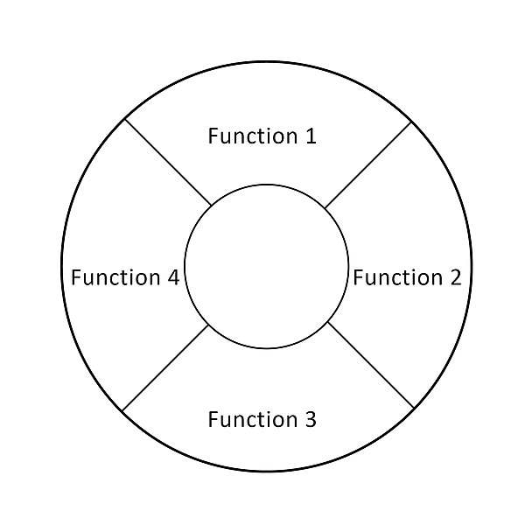
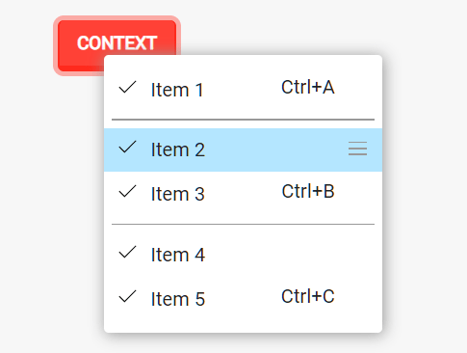
Fitts’ Law: pointing, parameterised!
1. High Level qualitative-quantitative engagement
Further = harder / slower
So:
Minimise length of mouse moves
Control the user’s mouse-path
Spawn controls close to mouse position
time
Index of difficulty
T = a + b log2(2D / W)
“delay”
“acceleration”
Notes:
The other thing we can do is make the endpoint relative to the user - spawn a menu right next to the cursor. This is the reason why it is now very common to use menus that spawn on right click or hotkey. And maybe we can make these menus radial: all other things being equal, that should minimise distance to a set of options.

Slide 9
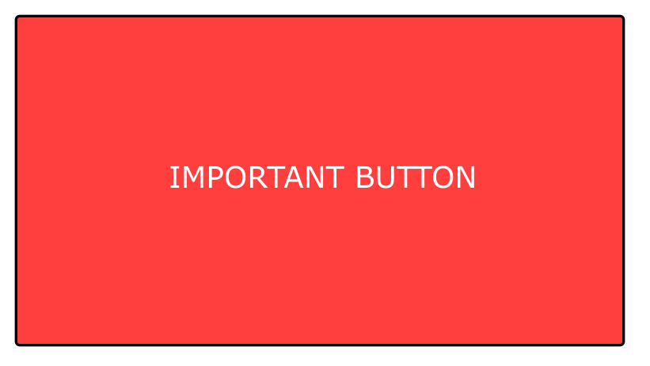
Fitts’ Law: pointing, parameterised!
1. High Level qualitative-quantitative engagement
bigger = easier
So:
Make UI elements biger when time pressure, or risk of error are high
time
Index of difficulty
T = a + b log2(2D / W)
“delay”
“acceleration”
Notes:
But say you’re stuck with high time-pressure and a small target, and for whatever reason, you can’t spawn a menu right by the mouse. Well, the equation says that wider target, in the direction of movement, will be easier. So you can use bigger targets.

Slide 10




Fitts’ Law: pointing, parameterised!
1. High Level qualitative-quantitative engagement
Alerting the designer to high error rates
Minimise cost of error
Edges and Corners Are Special: infinite width
time
Index of difficulty
T = a + b log2(2D / W)
“delay”
“acceleration”
Notes:
But maybe you’re working on a very small screen, or dealing with touch, so you don’t know where the cursor is? Well maybe you just accept that you will have higher error rates, but aim to minimise how frustrating those errors are: you make sure that the cost of error is low: maybe you make it easy to undo, or you put only one option in each direction, so that overshoots and undershoots result in no action rather than a wrong action which is frustrating and costly to undo.
Also there are some special areas on the screen: the edges and corners are like walls to movement: the user gets caught there and you can use that to create an effectively infinite width target: the user can get to the target as fast as they can move their hands, with little worry about error. This explains why a lot of modern web pages have a lot of interaction areas either close to the centre, or off to the edges, with not a lot in between. [GOOGLE EXAMPLE]
So Fitts’ law gives us a quantitative model, but even before we engage with the maths very deeply, we can read off a lot of broad qualitative rules and inspirations.

Slide 11
Fitts’ Law: pointing, parameterised!
2. Mathematical Engagement
Build tools to analyse layouts and guide design
Analyse use of nested vs flat menus
Calculate times for paths through website
Create adaptive interfaces?
time
Index of difficulty
T = a + b log2(2D / W)
“delay”
“acceleration”
Notes:
But obviously, if you have a quantitative model, you can also engage with the numbers. This is the second way of engaging with Fitts’ Law, and it really just refines and extends the first.
For example, you can build tools that analyse various scenarios of interface use, to pick out potential problems. And maybe you can build a tool that helps designers lay out a screen given a particular set of buttons, space and time-constraints and acceptable error rates.
And you can analyse times for various routes through a web-page.
Maybe you could design interfaces that adapt a site design on the basis of data you have gathered about users’ routes through the site, using the law as part of an optimisation algorithm.

Slide 12


Fitts’ Law: pointing, parameterised!
3. Further Theory Building
Does mouse-path efficiency nudge behaviour?
Easier: encourage purchases?
A GREAT PRODUCT
A GREAT PRODUCT
time
Index of difficulty
T = a + b log2(2D / W)
“delay”
“acceleration”
Notes:
And then finally we come to the third approach: again this just builds on the first two approaches, and refines them.
Fitts law has been highly productive for the development of new theories
It suggests a lot of other ideas that might not be immediately obvious, or might not be strictly implied by the theory alone, but that stand out when you think of other psychological findings.
Well research in psychology indicates that our behaviour can be influenced by very small changes in perceived efficiency and effort.
Fitts Law tells us about effort and efficiency of interface interactions. Given two layouts, it is more efficient for the user to select one particular option than another, based on a given starting point for the cursor starts. Does that mean the user is more likely to select that more efficient option?
Well as much as we would like to think we are better than this, it seems that we may just be this lazy. It has been shown that if you move the “add to cart” button closer to the mouse position most users begin at when reviewing a product, you can get a big increase in sales: it seems that less friction, in the form of effort and possibility of error, standing in the way of the purchase, increases likelihood of purchasing. And it was a big effect: 34%. [CHOPRA 2010]

Slide 13
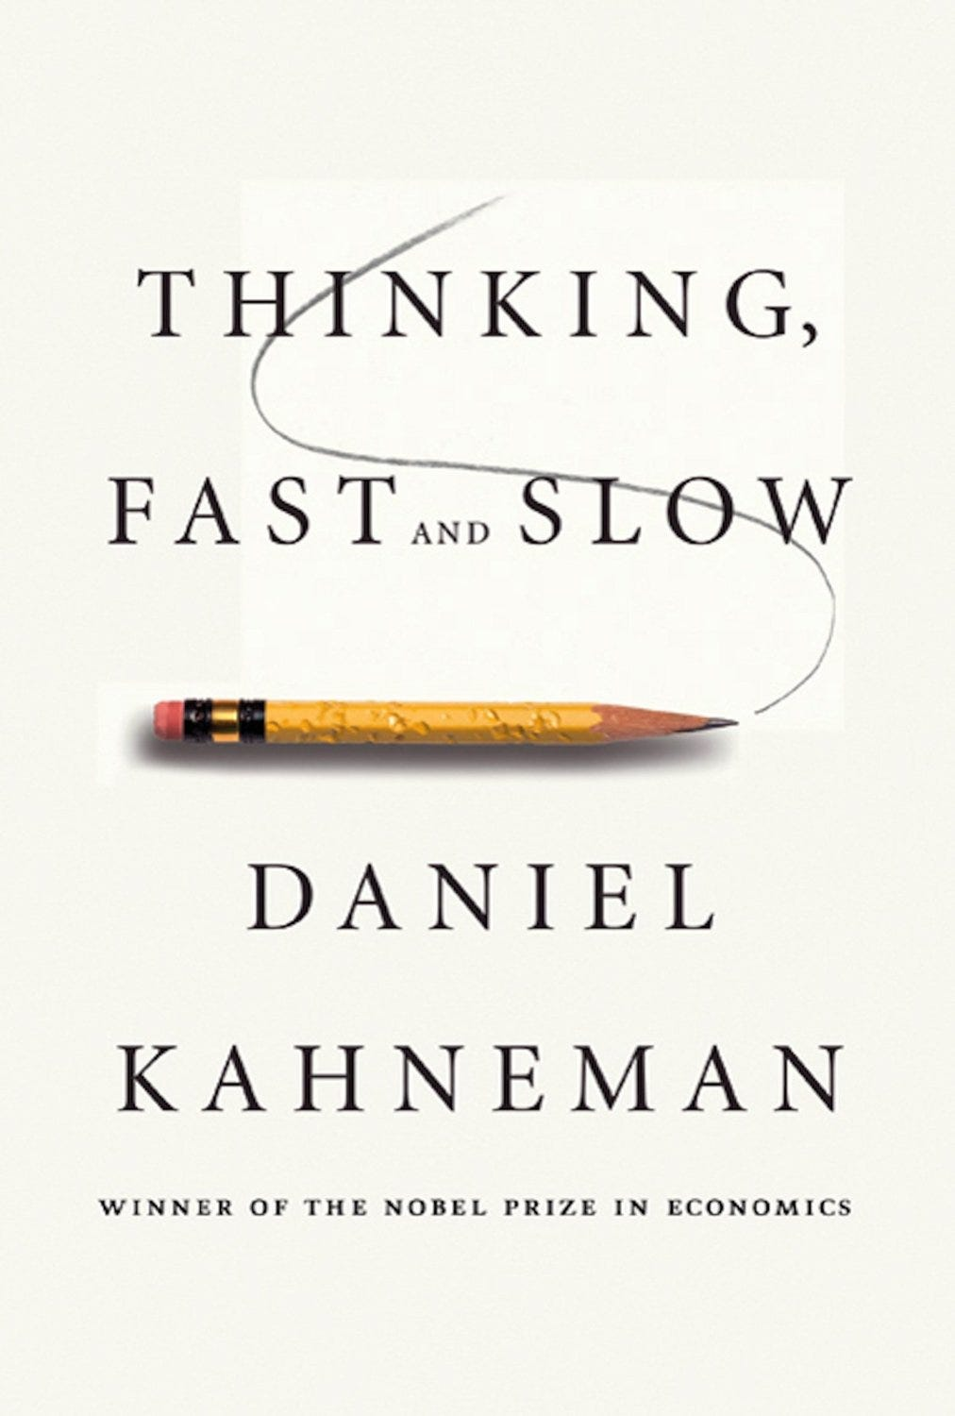

Fitts’ Law: pointing, parameterised!
3. Further Theory Building
Does mouse-path efficiency nudge behaviour?
Easier: encourage purchases?
Harder: increase thoughtfulness?
Extensions: 3d pointing in VR?
time
Index of difficulty
T = a + b log2(2D / W)
“delay”
“acceleration”
Notes:
Also moving away from making things easier for the user, how about making something harder? Does this discourage use? It seems like a good hypothesis, and it seems pretty easy to test.
Some of you may have heard of this book “Thinking Fast and Slow”. It is a popular psychology book which describes the psychological theory that we have two broad modes of cognition: one instinctive and fast, the other reflective and slow. There is evidence that this second, reflective, mode of cognition is encouraged by adding just a little bit of difficulty to a task. So, given that we have said that Fitts’ law describes efficiency and difficulty, can we use Fitts’ law to make users think more carefully? If we ask users to make a decision using a precise movement over a longer distance, perhaps that will make them think twice before rushing into that decision: so perhaps we’ll design interfaces like this for important decisions? Again, it’s a nice hypothesis and easy to test. I don’t know of any research that has yet tested it.
Finally, can we extend Fitts’ law itse.f? The law assumes movement is on a flat plane. What about other scenarios? How does movement in a 3d space work - e.g. in VR?
Some people have done work in these areas, and there’s a lot of space left to explore.

Slide 14
READING:
READING OPTION 1: A Deep Dive Into Fitts’ Law https://timmarco.com/fitts/
NEXT:
GOMS: Goals Operators Methods and Selection rules
Notes:
OK, so that was Fitts’ law. I said you had three options for reading this week.
So here’s your first option – if you think Fitts law seems interesting, try this website, which gives a more in depth look at the theory, with a great interactive presentation
We’ll finish this video with a shorter segment on another approach to cognitive modelling in HCI - GOMS.
You’ll be playing with GOMS in this week’s seminar.

Slide 15
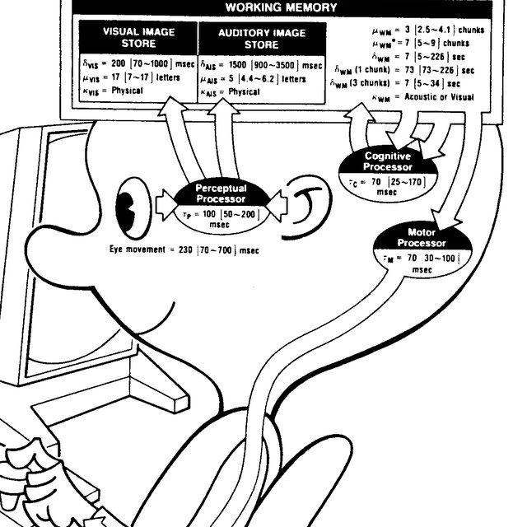
GOMS: Goals Operators Methods and Selection rules
Analyse times for input tasks for a skilled user
Again, grounded in information processing models from cognitive psychology
Aims to be easy for designers to apply
Notes:
This is a family of predictive models of human performance on more general input tasks.
It can handle a wider range of input behaviours than Fitts’ law - keystrokes, button pushes, clicks, pointer movement. It aims to provide an *engineering model* of human performance, to produce quantitative predictions of performance during development and design, before we do any user testing.
To meet this goal we need a model which is reliable across a reasonably wide range of tasks, without being too sensitive to particular conditions - so we’re going to see some simplifications and abstractions of behaviour to get us a working model. One simplification here, for example, is that we assume the user is already skilled in the task. This deliberately approximate approach is intentional: we want to find the level of detail necessary to help design, without making the model intractable, or making it easy to over-fit it to very specific circumstances of use.
Like Fitts’ Law, GOMS is built on psychological theory, and many researchers have been able to engage with it at this level, testing and extending the model.
At the same time, it aims to package up this knowledge into a system which can be used readily by designers and system builders.

Slide 16
GOMS: Goals Operators Methods and Selection rules
Decomposes tasks into on atomic actions (operators) and assigns times
Various versions of varying complexity
Simple: KLM-GOMS
Complex: CPM-GOMS
Notes:
GOMS offers a model comprised of various modules, which allows to us model tasks.
Specifically it allows us to break down, or “decompose” tasks on a standard desktop or laptop computer into a series of smaller atomic operations
These are the operators of the title
And having done this, it helps us find the times for these various atomic operations, and estimate the time for the task.
So it can deal with things like the effects of layout on key-strokes, and mouse movement, and responding to displayed information. The advantage of this over something like Fitts’ Law is that it allows more aspects of the interface to be captured and optimised together. With Fitts’ Law we noted that in each case, other factors had to be taken into account separately. GOMS aims to eliminate some of this messiness. There are various GOMS models, from the very approximate and easy to use **Keystroke Level GOMS (KLM-GOMS)**, which ignores things like task-switching, and application of knowledge, to complex models like **CPM-GOMS** which allows for the modelling of multiple tasks being carried out in parallel.

Slide 17
GOMS: Goals Operators Methods and Selection rules
GOALS: what the user wants to do
OPERATORS: individual actions
METHODS: how to combine actions to achieve the goal
SELECTION RULES: how to choose between potential METHODS of the task
Notes:
GOMS modelling relies on these four components: Goals, Operators, Models and Selection Rules
**Goals** - simply the user’s goals - what they want to achieve with the software over a given period (seconds, minutes, hours). These can be broken into sub-goals. Say I want to write a tetris imitation - I can break that task into several sub-goals all of which can be done with a computer: I need to find out the rules of tetris, download libraries, implement the code, make the art work, test the game
**Operators** are actions which can be performed on the computer, and are allowed by the software and hardware. At the time of GOMS most systems used command line interfaces, so this could all be described in terms of keypresses. Now we have GUIS, so operators might also include button pushes, mouse clicks, drags, and various other GUI actions. In principle, any meaningful behaviour could be defined and given some time estimate or heuristic for estimating time: eye movements on screen, for example.
**Methods** concern “how to achieve the goal”. They are collections of sub-goals and operators, learned by the user, which are combined together to accomplish the overall goal. It’s easy to see that there might be more than one method to accomplish the goal in a particular system.
- **Selection Rules** are the rules the user follows when deciding which method to use to achieve the goal, given the particular circumstances they are in.

Slide 18
GOMS: Goals Operators Methods and Selection rules
Applying GOMS
KLM OPERATORS:
K - press a key
P - point to location on screen with mouse
H - move hands to home position on the keyboard
M - mentally preparing to perform an action
R - system response while the user waits for the system.
Notes:
#### How can we apply GOMS?
As I said, there are various versions of GOMS, we’ll focus on one of the simplest of the GOMS models **KLM-GOMS**, or **Keystroke Level GOMS**.
KLM-GOMS in its original form had just 6 operator classes. We break a task into combinations of these tasks, work out the times for these tasks using rules and tables of empirical results, and then add up the times.
- K - press a key
- P - point to location on screen with mouse
- H - move hands to home position on the keyboard
- M - mentally preparing to perform an action
- R - system response while the user waits for the system.
For each of these operators researchers estimated execution times based on empirical research, and for some of these special heuristics for adjusting timings are provided. You’ll be going through an example of this in this week’s seminar

Slide 19
GOMS: Goals Operators Methods and Selection rules
GOMS Limitations?
No Fatigue
No Learning (expert users)
No Errors (expert users)
All tasks are goal-directed
Goal is clear at start of the task (no problem solving)
Notes:
#### imitations
GOMS does not deal with a range of other factors, which might affect use - like fatigue, creativity, engagement with colleagues. It does not handle errors, and assumes an expert user. It doesn’t handle learning. It also assumes all tasks are goal directed, and that the goal is well defined at the start of the activity, and sub-activity - as such it neglects problem solving. Also as in Fitts, it only tells us about speed: this is only a very narrow dimension of system use. It doesn’t tell us about how enjoyable or pleasant a system is to use. Aside from the fact that we want systems to be enjoyable for its own sake, this may affect accuracy of the model in real world cases: we may find that if a system is too boring, performance may drop off over time.
Returning to GOMS - there is evidence that GOMS does a good job of capturing complexity and efficiency of actions at the interface in at least a good number of cases. There are at least sufficient spans of time during interaction that the user is engaging in tasks which GOMS can model to make it useful.

Slide 20
Oussama Metatla (and Dan Bennett)
Next…
Week 2: The First Wave
Chunk 3: Heuristic models, and disagreements with the first wave

Slide 21
#HCI
_Theory

